Slide 1
GenAI & Prompt Engineering
Anshu Pandey

Slide 2
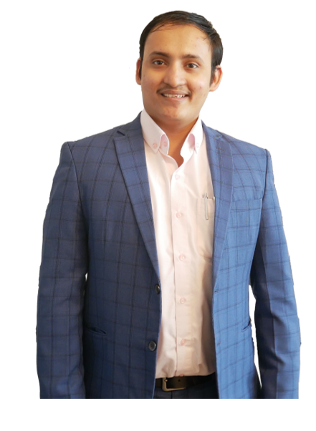
Anshu Pandey
AI & Data Consultant
Formerly Progarm Director at Bootup Ventures
10+ years into Analytics, AI & Automation
Microsoft Certified Trainer, Wiley Certified Trainer
Delivered 200+ training programs on Advance Analytics & AI

Slide 3
Program Structure
Day | Plan
Day 1 (AI Introduction) | Introduction to the course Introduction to Machine Learning Supervised Learning: regression,classification Unsupervised learning : Clustering Deep learning : neural network for text and vision usecase Analyze Machine Learning Libraries and Tools Practical problems : bias and fairness, deploying ML models in production, Monitoring and scaling ML systems hands on – project/casestudy
Day 2 (NLP) | Introduction to Natural Language Processing Preprocessing and Text Representation Text classification Understand Language Models Explore Sentiment Analysis and Opinion Mining UnderstandText Classification and Categorization Analyze NLP Libraries and Tools Word embedding Explore Named Entity Recognition (NER) hands on – project/casestudy
Day 3 (LLMs) | Introduction to Large Language Models Architecture of LLM stack Industry practices , infrastructure and tools related to LLM stack Vector store and related infrastructure Embedding and ETL(Extraction,Transformation,Loading) pipeline

Slide 4
Program Structure
Day | Plan
Day 4 (Prompt Engineering) | Introduction to Prompt Engineering Explore Elements of a prompt Explore different prompt engineering principles/techniques Prompt engineering for SDLC – part1
Day 5 (Prompt Engineering) | Techniques for Rewriting, Summarizing, Inferring Prompts ChatGPT: Get best out of GenAI with Code Interpreter and Plugins ChatGPT for Developers Examples of prompting: zero-shot prompts, few-shot examples, chain of thoughts prompting, ReAct Prompting Prompt Patterns: Combining Patterns, Outline Expansion Pattern, Menu Actions Pattern, Fact Check List Pattern, Tail Generation Pattern, Semantic Filter Pattern Advanced Prompt Patterns and Techniques
Day 6 (Prompt Engineering) | Prompt engineering for SDLC – part2 Prompt engineering for working with vectorized data Create Prompts for Specific Use Cases

Slide 5
Program Structure
Day | Plan
Day 7 (openAI) | Introduction to OpenAI Products and Features python sdk basics openai integraton for usecases-without embeddings openai integraton for usecases- with embeddings
Day 8 (Practice) | Exploring openAI Enterprise Handson with use cases
Day 9 (Practice) | Capstone Project

Slide 6
Artificial Intelligence

Slide 7
What is Artificial Intelligence?
“The capability of a machine to imitate intelligent human behavior“
Notes:
the theory and development of computer systems able to perform tasks normally requiring human intelligence, such as visual perception, speech recognition, decision-making, and translation between languages

Slide 8
What is Artificial Intelligence?
Machine
or Computers
Artificial Intelligence
+
Intelligence
=

Slide 9
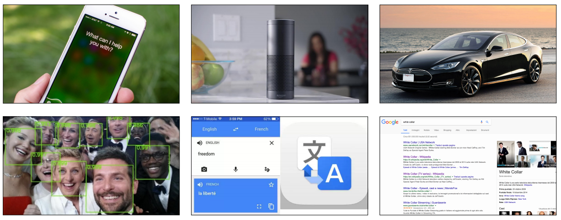
Artificial Intelligence in everyday products

Slide 10
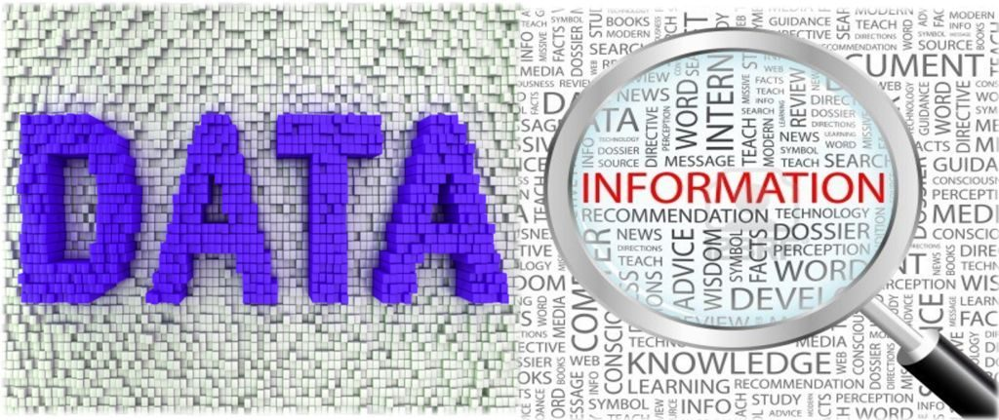
What is Data?
Structured
Business Data, Excel, CSV
Unstructured
Text, Images and Speech

Slide 11
AI Landscape
Artificial Intelligence Collection of algorithms used to build intelligence

Slide 12
AI Landscape
Artificial Intelligence Collection of algorithms used to build intelligence
Machine Learning algorithms which use DATA to build intelligence

Slide 13
AI Landscape
AI Landscape
Artificial Intelligence Collection of algorithms used to build intelligence
Machine Learning algorithms which use DATA to build intelligence
Deep Learning AUTOMATED FEATURE ENGINEERING

Slide 14
AI Landscape
AI Landscape
Artificial Intelligence Collection of algorithms used to build intelligence
Machine Learning algorithms which use DATA to build intelligence
Deep Learning AUTOMATED FEATURE ENGINEERING
Data Analytics
Statistics, Visualization
Structured Data

Slide 15
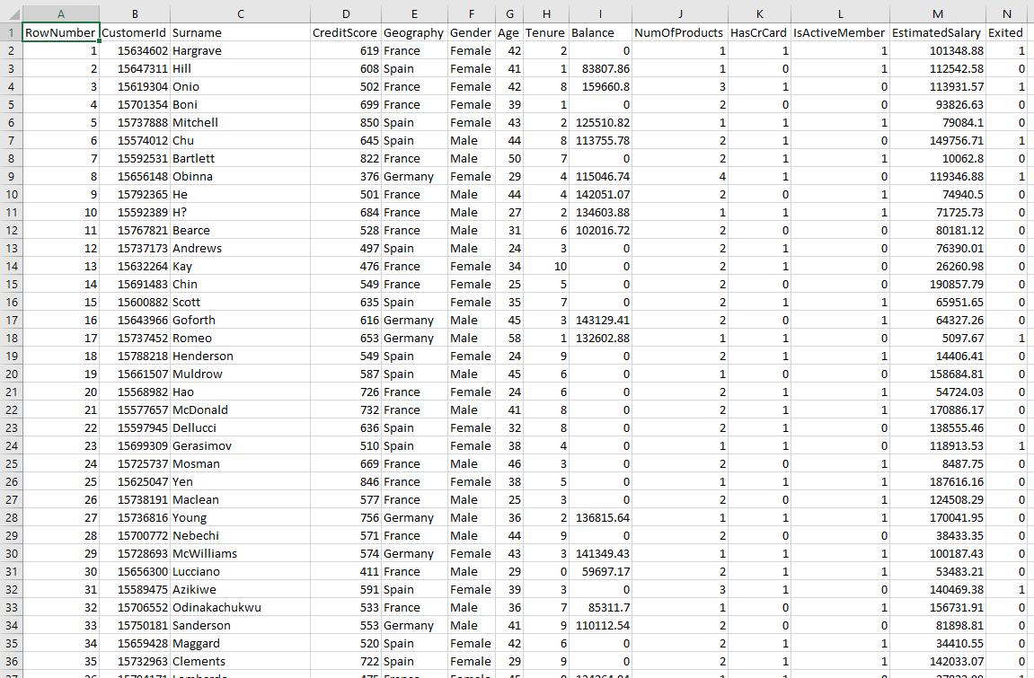

Slide 16
AI Landscape
AI Landscape
Artificial Intelligence Collection of algorithms used to build intelligence
Machine Learning algorithms which use DATA to build intelligence
Deep Learning AUTOMATED FEATURE ENGINEERING
Data Analytics
Statistics, Visualization
Structured Data
DATA
SCIENCE

Slide 17
AI Landscape
AI Landscape
Artificial Intelligence Collection of algorithms used to build intelligence
Machine Learning algorithms which use DATA to build intelligence
Deep Learning AUTOMATED FEATURE ENGINEERING
Data Analytics
Statistics, Visualization
Structured Data
Image Processing
Images,Video(w/o audio)
Unstructured Data
DATA
SCIENCE

Slide 18
AI Landscape
AI Landscape
Artificial Intelligence Collection of algorithms used to build intelligence
Machine Learning algorithms which use DATA to build intelligence
Deep Learning AUTOMATED FEATURE ENGINEERING
Data Analytics
Statistics, Visualization
Structured Data
Image Processing
Images,Video(w/o audio)
Unstructured Data
DATA
SCIENCE
COMPUTER VISION

Slide 19
AI Landscape
AI Landscape
Text/Speech
Processing
Text/Audio
Unstructured Data
Artificial Intelligence Collection of algorithms used to build intelligence
Machine Learning algorithms which use DATA to build intelligence
Deep Learning AUTOMATED FEATURE ENGINEERING
Data Analytics
Statistics, Visualization
Structured Data
Image Processing
Images,Video(w/o audio)
Unstructured Data
DATA
SCIENCE
COMPUTER VISION

Slide 20
AI Landscape
AI Landscape
Text/Speech
Processing
Text/Audio
Unstructured Data
Artificial Intelligence Collection of algorithms used to build intelligence
Machine Learning algorithms which use DATA to build intelligence
NATURAL
LANGUAGE
PROCESSING - NLP
Deep Learning AUTOMATED FEATURE ENGINEERING
Data Analytics
Statistics, Visualization
Structured Data
Image Processing
Images,Video(w/o audio)
Unstructured Data
DATA
SCIENCE
COMPUTER VISION

Slide 21
AI Landscape
Text/Speech
Processing
Text/Audio
Unstructured Data
Artificial Intelligence Collection of algorithms used to build intelligence
Machine Learning algorithms which use DATA to build intelligence
NATURAL
LANGUAGE
PROCESSING - NLP
Deep Learning AUTOMATED FEATURE ENGINEERING
Data Analytics
Statistics, Visualization
Structured Data
Image Processing
Images,Video(w/o audio)
Unstructured Data
DATA
SCIENCE
COMPUTER VISION

Slide 22
Artificial Intelligence
Data Science
Computer Vision
Natural Language Processing

Slide 23
Artificial Intelligence
Data Science
Predicting Stock prices, housing prices or any other item prices based on historical data
Predicting whether customer will buy a product or not, customer will churn or not
Classifying the customers in different known groups
Risk predictions for financial transactions.
Fraud Detection from transactional data
Segmentation of customers, stocks and server logs
Predicting patient readmission into hospital
Detecting anomalies in access management, data control
Building product recommendation systems
Computer Vision
Natural Language Processing

Slide 24
Artificial Intelligence
Data Science
Face Recognition, Emotion Recognition
Optical Character Recognition
Document verification, authentication
Object Detection and Classification from images
Identifying forgery in the images
Vehicle number plate, type recognition
Self Driving Cars – lane detection, traffic sign classification, Behavioural Cloning
Motion Detection from videos
Image restoration, colouring and pattern transfer
Action Prediction
Computer Vision
Natural Language Processing

Slide 25
Artificial Intelligence
Data Science
Text/document classification
Social Media Text mining and Analysis
Speech to Text and Text to Speech conversion
Caption generation
Machine Translation
Sentiment analysis from text
Chatbots
Speaker recognition
Personal Assistant, Sentence Correction
Text Generation, Similarity Matching, Topic Modelling
Computer Vision
Natural Language Processing

Slide 26
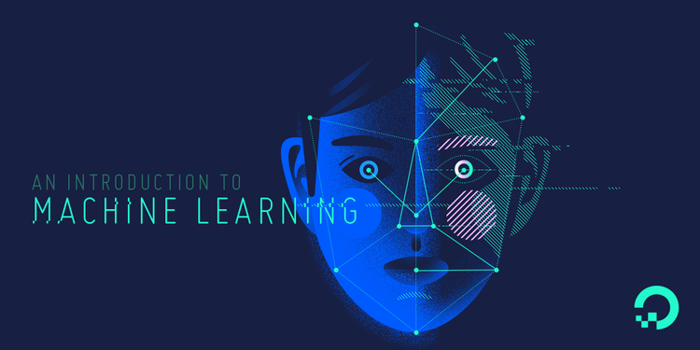

Slide 27
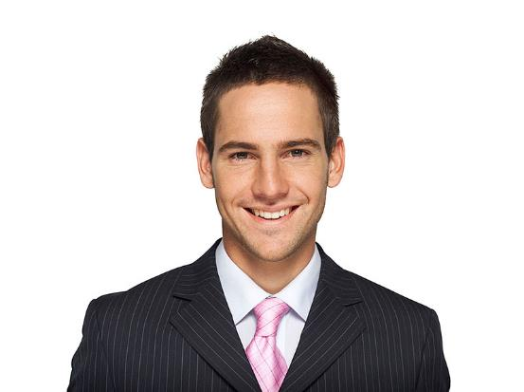
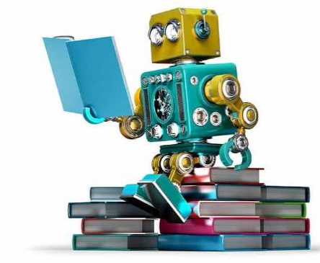
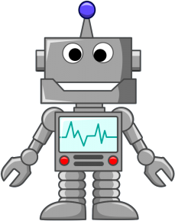

Slide 28
Machine learning is a field of computer science that gives computers the ability to learn without being explicitly programmed.
—Arthur Samuel, 1959

Slide 29
Applications of Machine Learning
Financial Predictions, Fraud Detections
Loan Approval
Data Mining – Web Click Data, Medical Records, Diagnosis
Predictive Maintenance
Ad plus user information
Computer Vision – Face Recognition, Self Driving Cars, OCR
Churn Prediction, Customer Segmentation, Sales Forecasting
Voice recognition, Chatbots, Sentiment Analysis, Machine Translation

Slide 30
Manufacturing | Retail | Financial Services
Predictive maintenance or condition monitoring Warranty reserve estimation Propensity to buy Demand forecasting Process optimization Telematics | Predictive inventory planning Recommendation engines Upsell and cross-channel marketing Market segmentation and targeting Customer ROI and lifetime value | Risk Analytics and Regulations Customer Segmentation Cross-selling and up-selling Sales and marketing campaign management Credit worthiness evaluation
Travel and Hospitability | Health Care and Life Sciences | Energy, Feedstock and Utility
Aircraft scheduling Dynamic pricing Social media — consumer feedback and interaction analysis Customer complaint resolution Traffic patterns and congestion management | Alerts and diagnostics from real-time patient data Disease identification and risk stratification Patient triage optimization Proactive health management Healthcare provider sentiment analysis | Power usage analytics Seismic data processing Carbon emissions and trading Customer-specific pricing Smart grid management Energy demand and supply optimization

Slide 31
Programming Languages -
Python | R

Slide 32
Machine Learning Cloud Platforms -
Microsoft Azure ML Studio
https://azure.microsoft.com/en-us/services/machine-learning-studio/
Amazon Machine Learning
https://aws.amazon.com/aml/
SAP Leonardo Machine Learning
https://www.sap.com/india/products/leonardo/machine-learning.html
Google ML Platform
https://cloud.google.com/products/machine-learning/
IBM Machine Learning
https://www.ibm.com/analytics/data-science/machine-learning

Slide 33
What to learn in machine Learning?
Programming and
Tools
30%
Python/R, spark etc.
The Math behind
Machine Learning
70%
Probabilistic Theory, Statistics and Linear Algebra

Slide 34
What to learn in Machine Learning?
R/Python for Machine Learning
Packages for Machine Learning – Tensorflow, keras etc.
Handling Big Data
Practice, practice & practice
Optimization, boosting Techniques
Statistics for Data Science
Math behind Machine Learning Algorithms

Slide 35
Machine Learning Techniques

Slide 36
Discovering patterns in unlabeled data.
Cluster similar documents based on the text content.
Learning based on feedback or reward.
Learn to play chess by winning or losing.
Learning with a labeled training set.
Email spam detector with training set of already labeled emails.
Supervised Learning
Unsupervised Learning
Reinforcement Learning

Slide 37




Supervised Learning
We know what we are trying to predict. We use some examples that we (and the model) know the answer to, to “train” our model. It can then generate predictions to examples we don’t know the answer to.
Examples: Predict the price a house will sell at. Identify the gender of someone based on a photograph.

Slide 38


Unsupervised Learning
We don’t know what we are trying to predict. We are trying to identify some naturally occurring patterns in the data which may be informative.
Examples: Try to identify “clusters” of customers based on data we have on them

Slide 39
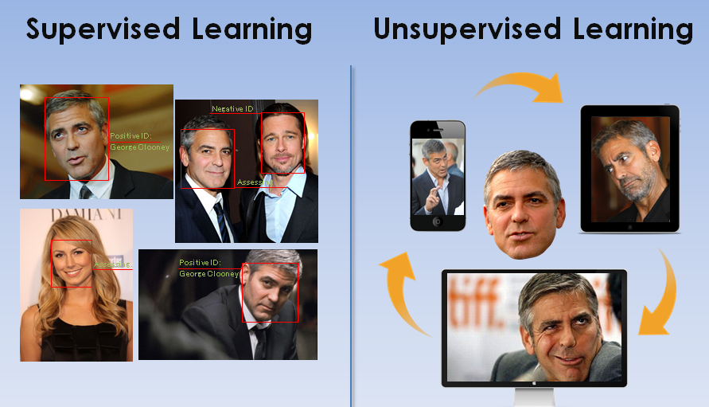

Slide 40
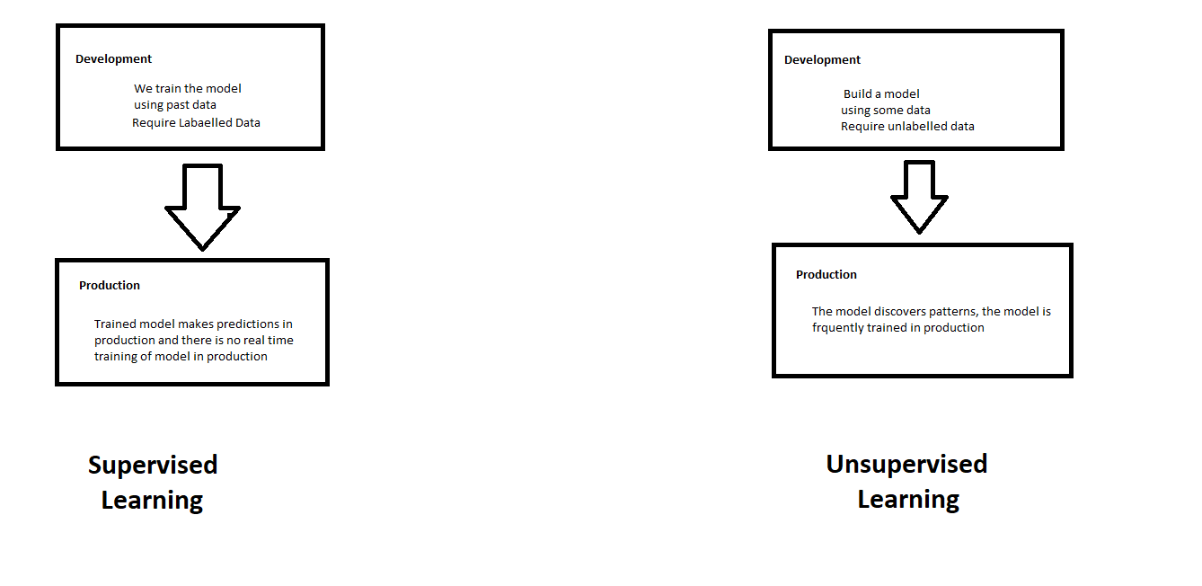
Supervised and Unsupervised Learning

Slide 41
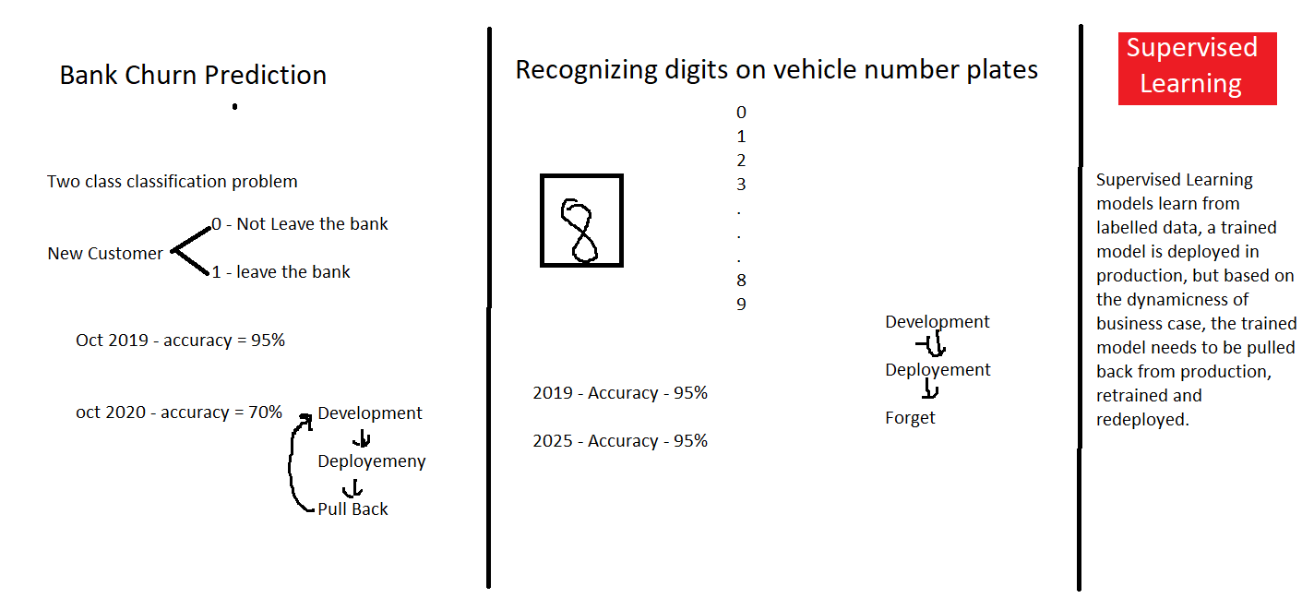

Slide 42
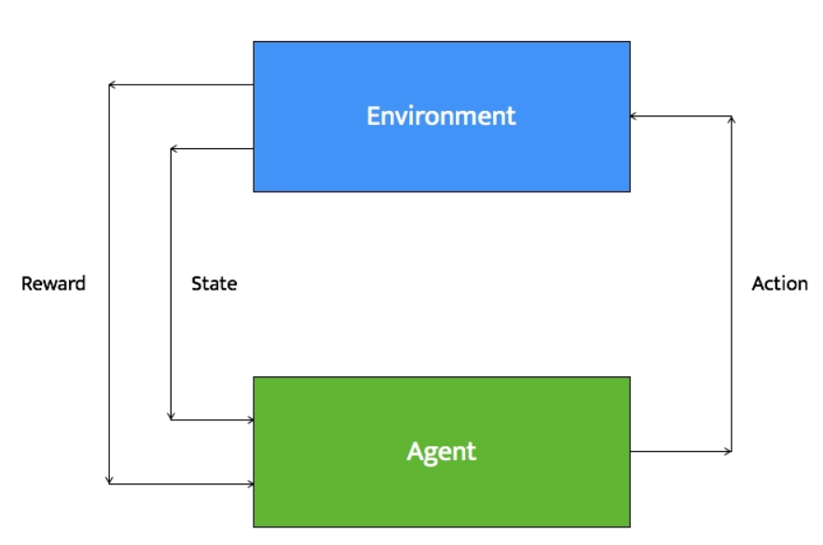
Reinforcement Learning
Reinforcement learning systems can do multiple things simultaneously -- learn by performing a trial and error search, learn the model of the environment it is in, and then use that model to plan the next steps.
Example: Let's consider a robot whose job is to explore a new building. It has to make sure it has enough power left to come back to the base station. This robot has to decide if it should make decisions by considering the trade off between the amount of information collected and the ability to reach back to base station safely.

Slide 43
Types of Problems in Machine Learning

Slide 44
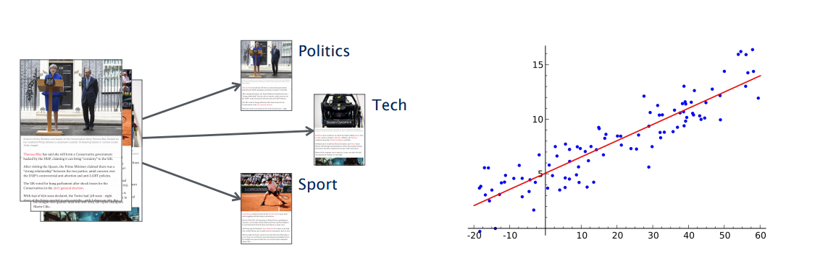
Types of Problems in Supervised Machine Learning -
Classification
(discrete set of possible outcomes)
Regression
(possible outcome can by any numerical value with in a particular continuous range)

Slide 45
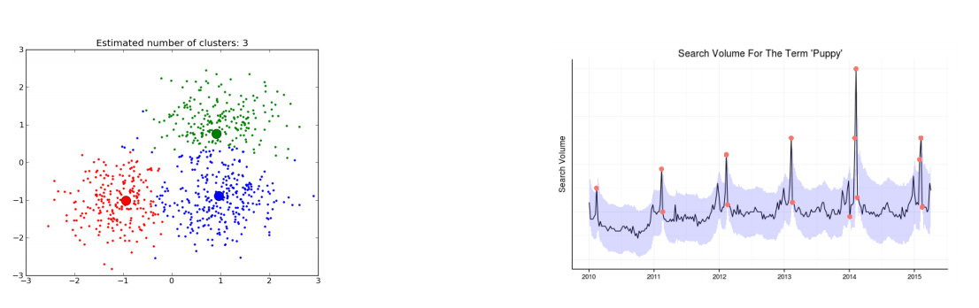
Types of Problems in Unsupervised Machine Learning -
Clustering
(categorization of samples based on similarity in features)
Anomaly Detection
(detecting an anomaly in a general pattern)

Slide 46

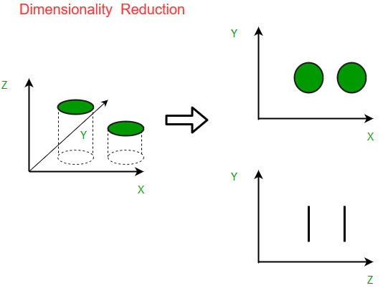
Types of Problems in Unsupervised Machine Learning -
Recommendation Systems
(profiling of users and items and recommending relevant items to user)
Dimensionality Reduction
(Reducing dimensionality/size of data)

Slide 47
Deep Learning

Slide 48
Deep Learning
Deep Learning is part of the machine learning field of learning representations of data. Exceptional effective at learning patterns.

Slide 49
Deep Learning in one slide
What is it:
Extract useful patterns from data.
How:
Neural network + optimization
How (Practical):
Python + TensorFlow & friends
Hard Part:
Good Questions + Good Data
Why now:
Data, hardware, community, tools, investment
Where do we stand?
Most big questions of intelligence have not been answered nor properly formulated
Exciting progress:
Face recognition
Image classification
Speech recognition
Text to speech generation
Handwriting transcription
Machine translation
Medical diagnosis
Cars: drivable area, lane keeping
Digital assistants
Ads, search, social recommendations
Game playing with deep RL

Slide 50
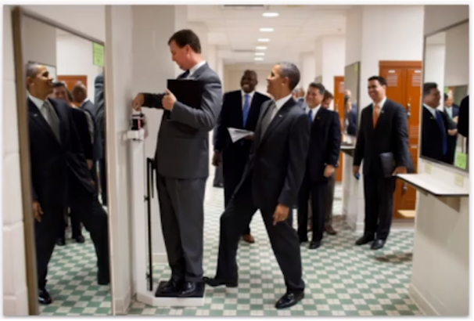
What we can’t do with Deep Learning?
Mirrors
Sparse information
3D Structure
Physics
What’s on peoples’ minds?
What happens next?
Humor

Slide 52





Prepare to vote
This presentation has been loaded without the Sendsteps add-in.
Want to download the add-in for free? Go to https://dashboard.sendsteps.com/.
Internet
1
1
2
2
TXT
1
2
0

Slide 53

Which of the following a scenario for unsupervised ML?
The question will open when you start your session and slideshow.
Predicting ride fares using historical data
Discovering patterns from customer ride dataset
Estimating total number of bookings for next 4 weeks
This presentation has been loaded without the Sendsteps add-in.
Want to download the add-in for free? Go to https://dashboard.sendsteps.com/.
Internet | "Description of message sending methods"
TXT | "It will be inserted after you've started a session"
0
0
Time: 20s

Slide 54
Which of the following a scenario for unsupervised ML?
We will set these example results to zero once you've started your session and your slide show.
In the meantime, feel free to change the looks of your results (e.g. the colors).
A.
Predicting ride fares using historical data
33.3%
B.
Discovering patterns from customer ride dataset
66.7%
C.
Estimating total number of bookings for next 4 weeks
100.0%
Closed

Slide 55
What is supervised learning?
The question will open when you start your session and slideshow.
Learning without labels
Learning with Labels
Learning with reinforcement
This presentation has been loaded without the Sendsteps add-in.
Want to download the add-in for free? Go to https://dashboard.sendsteps.com/.
Internet | "Description of message sending methods"
TXT | "It will be inserted after you've started a session"
0
0
Time: 40s

Slide 56
What is supervised learning?
We will set these example results to zero once you've started your session and your slide show.
In the meantime, feel free to change the looks of your results (e.g. the colors).
A.
Learning without labels
33.3%
B.
Learning with Labels
66.7%
C.
Learning with reinforcement
100.0%
Closed

Slide 57
Consider a banking organization capturing data about their user’s financial behaviour, which of the following is an example of unstructured data captured from customers -
The question will open when you start your session and slideshow.
Customers financial transactional data
Records of call received in customer support call centre
Customer’s demographic and personal information saved in excel sheet
All above
This presentation has been loaded without the Sendsteps add-in.
Want to download the add-in for free? Go to https://dashboard.sendsteps.com/.
Internet | "Description of message sending methods"
TXT | "It will be inserted after you've started a session"
0
0
Time: 20s

Slide 58
Consider a banking organization capturing data about their user’s financial behaviour, which of the following is an example of unstructured data captured from customers -
We will set these example results to zero once you've started your session and your slide show.
In the meantime, feel free to change the looks of your results (e.g. the colors).
A.
Customers financial transactional data
25.0%
B.
Records of call received in customer support call centre...
50.0%
C.
Customer’s demographic and personal information saved in excel sheet
75.0%
D.
All above
100.0%
Closed

Slide 59
Your academic center has been funded as part of a Precision Medicine grant. You are in the process of integrating genomic data with phenotypical data you have archived derived from your electronic health record. The primary goal of your data analytics team is to find “undiscovered meaningful patterns” in the data. If you utilize machine learning for your inquiry what type of approach will you most likely use?
The question will open when you start your session and slideshow.
Classification
Regression
Clustering
Anomaly Detection
This presentation has been loaded without the Sendsteps add-in.
Want to download the add-in for free? Go to https://dashboard.sendsteps.com/.
Internet | "Description of message sending methods"
TXT | "It will be inserted after you've started a session"
0
0
Time: 20s

Slide 60
Your academic center has been funded as part of a Precision Medicine grant. You are in the process of integrating genomic data with phenotypical data you have archived derived from your electronic health record. The primary goal of your data analytics team is to find “undiscovered meaningful patterns” in the data. If you utilize machine learning for your inquiry what type of approach will you most likely use?
We will set these example results to zero once you've started your session and your slide show.
In the meantime, feel free to change the looks of your results (e.g. the colors).
A.
Classification
25.0%
B.
Regression
50.0%
C.
Clustering
75.0%
D.
Anomaly Detection
100.0%
Closed

Slide 61
Suppose you are working on stock market prediction, and you would like to predict the price of a particular stock tomorrow (measured in dollars). You want to use a learning algorithm for this.
The question will open when you start your session and slideshow.
Regression
Classification
Clustering
This presentation has been loaded without the Sendsteps add-in.
Want to download the add-in for free? Go to https://dashboard.sendsteps.com/.
Internet | "Description of message sending methods"
TXT | "It will be inserted after you've started a session"
0
0
Time: 20s

Slide 62
Suppose you are working on stock market prediction, and you would like to predict the price of a particular stock tomorrow (measured in dollars). You want to use a learning algorithm for this.
We will set these example results to zero once you've started your session and your slide show.
In the meantime, feel free to change the looks of your results (e.g. the colors).
A.
Regression
33.3%
B.
Classification
66.7%
C.
Clustering
100.0%
Closed

